Slide 1
Lecture 10 Harmony in the Family Family – the Basic Unit of Human Interaction Values in Human-to-Human Relationship

Slide 2
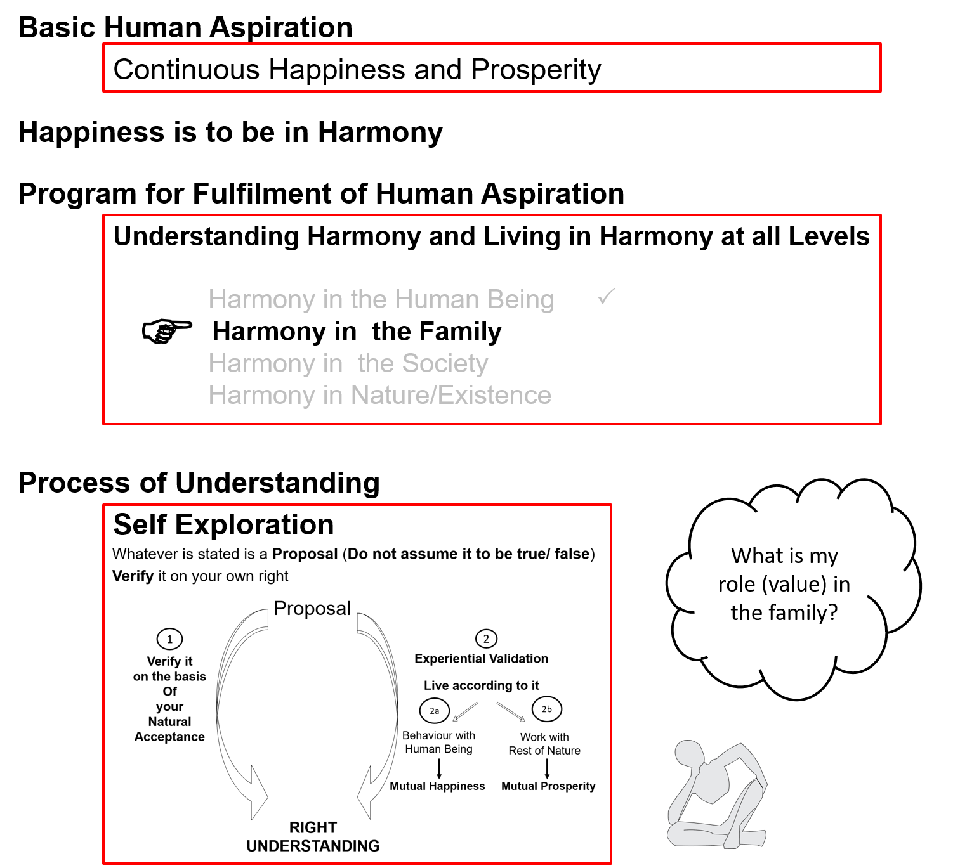

Slide 3
Human Being
Human Being is co-existence of Self and Body
The Self is central to human existence
The Body is used as an instrument by the Self
The need of the Self is continuous happiness. For this, the program of the Self is:
To understand harmony &
To live in harmony
Physical facility is required only for the nurturing, protection and right utilisation of the body
at all levels of being
As an individual human being
As a member of the family
As a member of society
As an unit in nature/existence

Slide 4
Family
The family is the next larger order – it is the basic unit or building block of human organisation
In the family, there are parents, grandparents, brothers, sisters, children, old people, uncles, aunts, cousins; and so many relatives and friends…
Our basic grooming for living in relationship begins in the family
The major issue in family is that of relationship
To live in relationship, it is essential to understand relationship

Slide 5
Family
Is relationship Important?
Really? Then why do we stop talking with the other for days and weeks?
So is ego more important than relationship?
We do want to live in relationship but as long as we consider human being to be body, it is not possible to understand relationship
Without understanding relationship, it is not possible to fulfill relationship, even though we do want to
i.e. if we are trying to assume relationship on the basis of body and trying to fulfill relationship on the basis of body, it does not work, in spite of all good intentions

Slide 6
Relationship
These are the four aspects to understand about relationship
Relationship is – between one self (I₁) and another self (I₂)
There are feelings in relationship – in one self (I₁) for the other self (I₂)
These feelings can be recognized – they are definite (9 Feelings)
Their fulfilment, evaluation leads to mutual happiness
We will explore each of these aspects one by one

Slide 7
1. Relationship is – between one self (I₁) and other self (I₂)
Of course the relationship is between one human being and another human being
Now if you look at the human being, who is recognising the relationship – the self or the body?
One self is recognising the relationship with another self
So, in that sense,
the relationship is between one self (I₁) and other self (I₂)
The body is used as an instrument by both of them

Slide 8
1. Relationship is – between one self (I₁) and another self (I₂)
We can see that the relationship is something which is there, not that we have to make relationship
We are related to each other – whether we understand it or not
The relationship is already there, we only need to understand it
When we understand relationship
We are able to see that relationship is there
We are able to accept the relationship and
think in terms of fulfilling the relationship
When we don’t understand it, the relationship is still there but:
We are not able to see the relationship
We are not able to accept the relationship and therefore
We are not able to fulfill the relationship

Slide 9
Harmony in the Family
Relationship is – between one self (I₁) and another self (I₂)
There are feelings in relationship – in one self (I₁) for the other self (I₂)
These feelings can be recognized – they are definite (9 Feelings)
Their fulfilment, evaluation leads to mutual happiness
Feelings in relationship:
1- Trust FOUNDATION VALUE
2- Respect
3- Affection
4- Care
5- Guidance
6- Reverence
7- Glory
8- Gratitude
9- Love COMPLETE VALUE

Slide 10
2. There are feelings in relationship – in one self for the other self
Feelings are in the self or in the body?
So there are feelings in relationship
– in one self (I₁) for the other self (I₂)
We can see that the core thing in relationship are the feelings
And one can understand this only when one can understand the self
So if one does not understand the self, one can not understand the relationship
The major crisis we are facing in relationship today is because of the failure to understand the self
We are trying to assume relationship on the basis of body and trying to fulfill relationship on the basis of body, and it does not work, inspite of all good intentions

Slide 11
3. These feelings can be recognized – they are definite (9 Feelings)
These are the 9 feelings
We can identify them, investigate them and understand that these are the feelings naturally acceptable to us in relationship with the other human being
1- Trust FOUNDATION VALUE
2- Respect
3- Affection
4- Care
5- Guidance
6- Reverence
7- Glory
8- Gratitude
9- Love COMPLETE VALUE

Slide 12
3. These feelings can be recognized – they are definite (9 Feelings)
Each of us can investigate if these feelings are naturally acceptable to us or not
What is naturally acceptable to you?
Feeling of trust or mistrust, opposition?
Feeling of respect or disrespect?
Feeling of affection or jealousy?
Feeling of care or exploitation?
Feeling of guidance or misguidance, confusion?
Feeling of reverence or irreverence?
Feeling of glory or inglorious feelings?
Feeling of gratitude or ingratitude?
Feeling of love or hatred?

Slide 13
3. These feelings can be recognized – they are definite (9 Feelings)
Feeling in relationship:
Are these feelings naturally acceptable to you?
Are these feelings naturally acceptable to the other?
1- Trust FOUNDATION VALUE
2- Respect
3- Affection
4- Care
5- Guidance
6- Reverence
7- Glory
8- Gratitude
9- Love COMPLETE VALUE

Slide 14
4. Their fulfilment, evaluation leads to mutual happiness
These feelings are naturally acceptable to me. Therefore having these feelings in myself leads to my happiness
These feelings are naturally acceptable to the other, therefore their fulfillment leads to happiness of the other
Can you see that problems in relationship are due to the absence of one or more of these feelings? We try to compensate with physical facility..
When you have these feelings in you, does it lead to your happiness?
When you express them to the other, does it lead to happiness of the other?
Evaluation is required to verify
whether I have these feelings or not
whether I have expressed these feelings to the other or not
whether it has reached to the other or not… and ultimately
whether the result is mutual happiness or not

Slide 15
Analysis of Current Situation
Generally, we are unhappy because these feelings are not in us
(since we have not understood relationship, feelings in relationship)
We try to get feelings (like respect) from the other in so many ways
(build big houses, wear fashionable clothes, get special haircuts, etc.)
If the other expresses these feelings to us, we feel happy
If the other does not express these feelings to us, we feel unhappy
The other is also trying to get these feelings from us!
It is like everyone is begging for feelings (like respect) and everybody’s bowl is empty

Slide 16
The Way Forward
The most fundamental thing is to understand these feelings. If I understand these feelings then I have these feelings in me
If I understand the feeling of respect, I have feeling of respect within me
If I have feeling of respect, I am comfortable (in harmony) within myself. This leads to my happiness
When I am happy, I naturally express the feeling of respect to the other. This makes the other happy
In this way, understanding the feeling, having the feeling, expressing the feeling and its right evaluation leads to mutual happiness

Slide 17
Lecture 11 ‘Trust’ The Foundational Value in Relationship

Slide 18
Trust (fo”okl)
Trust = to be assured
= to have the clarity that the other wants to make me
happy & prosperous

Slide 19
About the Other About Myself
The other broke a glass
If the other makes a mistake even once…
– I doubt his intention
– He makes mistakes intentionally
– I have a feeling of opposition, get irritated, angry…
– I reinforce “The other is bad”, can not improve
The glass broke by accident
Even if I make the same mistake 100 times…
– I never doubt my intention
– I make mistakes by accident
– I have a feeling “I am special”
– I reinforce “I am good”. I do not make effort to improve my own competence
Doubt on intention is a major reason for problems in relationships

Slide 20
Common Mistake in Relationship
I evaluate myself on the basis of my intention
I evaluate the other on the basis of their competence
I doubt their intention. I assume their lack of competence to be their lack of intention → I feel opposed to the other, I get irritated, angry…
I may not speak to the other for days… or even breakup the relationship… One may have lost many good friends like this…
?
Doubt on intention is a major reason for problems in relationships

Slide 21
Self Reflection
If you have unconditional, continuous trust on intention (natural acceptance) of the other and if the other is lacking competence, what will you do:
Try to improve his competence (and also improve your competence)
Get irritated
Get angry
Have a feeling of opposition
How many persons, in your family and friends, do you have trust on intention (natural acceptance)
This is fundamental. Trust on intention is the foundation of relationship
You can get an idea of the state of your understanding about relationship from this exploration…
Trust on Intention → Response
Doubt on Intention → Reaction

Slide 22
About the Other About Myself
The glass broke by accident
Even if the other makes the same mistake 100 times…
– I am clear about his intention
– I know the mistake is due to lack of competence, not a lack of intention
– I make effort to help improve his competence with a feeling of affection
I know that “he may have difficulty understanding… and also, I may have difficulty in explaining…”
The glass broke by accident
When I make a mistake even once…
– I am clear about my intention
– I know the mistake is due to lack of competence, not a lack of intention
– I make effort to improve my own competence (I am willing to learn)
Trust on intention is the starting point for mutual development

Slide 23
Trust: The Foundation of Relationship
With trust on intention, I feel related to the other
When I make a program with the other
I evaluate his competence as well as my competence and
I make the program in accordance with our current mutual competence
I am consistently making effort to learn, to improve my competence
If the other is lacking in competence, I am committed to help the other to improve his competence, without becoming irritated…
Trust on intention is the starting point for mutual development

Slide 24
Understanding Trust Assuming Trust
Being able to see that all human beings have the same natural acceptance (intention) as me
Trust on intention is founded on understanding (not based on events)
It does not keep changing with time or person. So it can be unconditional and continuous
“Trust” on competence is based on events – can keep changing
The last 5 times I lent her money, she returned it on time… so I can trust her
He said he will reach at 11, but look it is after 12 now… he always comes late… so how can I trust him to be on time?

Slide 25
Sum Up
Trust is to have the clarity that the other wants to make me happy & prosperous. It is the foundation of relationship
If I have trust on intention, I feel related to the other. I make a program with the other based on right evaluation of our mutual competence
In case the other is lacking in competence
I make effort to assure the other
I make effort to improve his competence once he is assured in relationship (and not before that)
If I lack competence, I become ready to take help from the other to improve my competence
If I have doubt on intention
I evaluate the other on the basis of his competence and assume the lack of competence to be the lack of intention; and thus feel opposed to him (while I evaluate myself on intention)
The feeling of opposition shows up as irritation or anger (and it may further lead to fighting, struggle and war)

Slide 26
Lecture 12 'Respect' – The Right Evaluation

Slide 27
Respect (lEeku)
Respect = Right Evaluation

Slide 28
Over evaluation – to evaluate for more than what it is
Under evaluation – to evaluate for less than what it is
Otherwise evaluation – to evaluate for other than what it is
Whenever the evaluation is not right, it is disrespect
Check for yourself in every interaction with others whether it is respect or disrespect. i.e.
It is right evaluation or
It is over / under / otherwise evaluation
Disrespect
Notes:
28

Slide 29
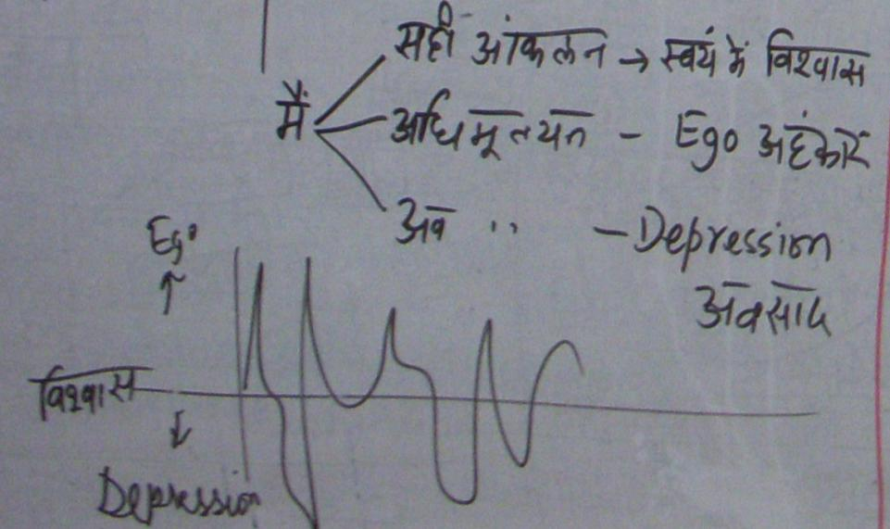
Self Confidence, Ego & Depression
Right Evaluation | Over Evaluation | Under / Otherwise Evaluation
Self Confidence | Ego | Depression
I am self referential | The other is my reference | The other is my reference
Assumptions…
Disharmony within
Tension
Frustration
Depression
Suicide etc.

Slide 30
Respect: Right Evaluation
Will the right evaluation be on the basis of the Self or the Body?

Slide 31
Respect: Right Evaluation – on the basis of the Self
Purpose
I want to live with continuous happiness & prosperity
The other also wants to live with continuous happiness & prosperity
Our purpose is same (on the basis of Natural Acceptance)
Program My program is to understand and to live in harmony at all 4 levels
The program of the other is also to understand and to live in harmony at all 4 levels (Individual, family, society and nature/existence)
Our program is same
Potential Desire, Thought & Expectation is continuous in me. I am endowed with Natural Acceptance
Desire, Thought & Expectation is continuous in the other. The other is also endowed with Natural Acceptance
Our potential is same
MINIMUM CONTENT of RESPECT
The Other is Similar to Me

Slide 32
Differences
So there are similarities at the level of the self
There are also differences between one human being and another:
On the basis of the body
On the basis of the self, i.e. how much of the potential has been realised
In living, are we:
Trying to accept the other as being similar to me
or
Trying to show that we are different from the other?

Slide 33
Differentiation
Differentiation
Body
Age
Gender
Race
Physical
Strength
The Gross Misunderstanding is
“Human Being = Body”
While the reality is
“Human Being is co-existence of Self & Body”
Notes:
33

Slide 34
Differentiation
Differentiation
Physical Facility
Wealth
Post
The Gross Misunderstanding is
“Physical Facility = Happiness”
While the reality is
“Happiness is being in a state of Harmony”
Notes:
34

Slide 35
Differentiation
Differentiation
Beliefs
Isms
Sects
Info
The Gross Misunderstanding is
“If the pre-conditioning of the other matches
my preconditioning, then the other is like me”
While the reality is
“Every Human Being is like me”
Notes:
35

Slide 36
Differentiation Hksn
Differentiation
Differentiation = Disrespect
Not Naturally Acceptable… Opposition, Movements…
Body
Physical Facility
lqfo/kk
Beliefs
ekU;rk
Age
Gender
Race
Physical
Strength
Wealth
Post
Isms
Sects
Info
Notes:
36

Slide 37
Respect: Right Evaluation – on the basis of the Self
1. Purpose – Our purpose (Natural Acceptance) is same
2. Program – Our program is same
3. Potential – Our potential is same
The Other is Similar to Me
4. Competence – On the basis of right evaluation of our mutual competence, I recognise our complementarity and fulfill it:
If the other has more understanding, is more responsible than me
I am committed to understand from the other
If I have more understanding, I am more responsible than the other
I live with responsibility with the other, unconditionally, unperturbed by the behaviour of the other
I am committed to facilitate understanding in the other (once the other is assured in relationship, and not before that)
COMPLETE CONTENT of RESPECT
The Other is Similar to Me. We are complementary to each other

Slide 38
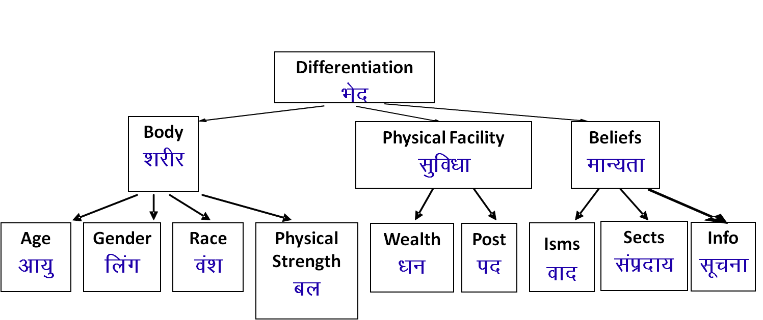
Differentiation Respect – on the basis of Self
I evaluate on the basis of body, physical facilities or belief (pre conditioning). I compare, compete, differentiate…
I am different from the other
We are competitors
I make effort to accentuate the difference, to manipulate, exploit the other
1. Our purpose (Natural Acceptance) is same
2. Our program is same
3. Our potential is same
The other is similar to me
We are complementary to each other
If the other has more understanding than me
- I am committed to understand from the other
If I have more understanding
1. I live with responsibility with the other
2. I am committed to facilitate understanding in the other (once the other is assured in relationship, and not before that)

Slide 39
Sum Up
Respect = Right Evaluation (with a feeling of trust on intention)
Under evaluation, over evaluation or otherwise evaluation is disrespect
Differentiation is disrespect
Respect on the basis of Self – The other is like me and we are complementary to each other
The only difference is in our level of understanding (how much of our desire, thought & expectation is on the basis of our Natural Acceptance). Fulfilling the relationship from my side leads to harmony (happiness) within me:
If the other has more understanding, he is more responsible than me
I am committed to understand from the other
If I have more understanding, I am more responsible than the other
I live with responsibility with the other, unconditionally, unperturbed by the behaviour of the other
I am committed to facilitate understanding in the other (once the other is assured in relationship, and not before that)

Slide 40
Lecture 13 Other Feelings in Relationship Love – The basis for Undivided Family

Slide 41
Harmony in the Family
Relationship is – between one self (I₁) and other self (I₂)
There are feelings in relationship – in one self (I₁) for other self (I₂)
These feelings can be recognized – they are definite (9 Feelings)
Their fulfilment, evaluation leads to mutual happiness
Feelings in relationship:
1- Trust FOUNDATION VALUE
2- Respect
3- Affection
4- Care
5- Guidance
6- Reverence
7- Glory
8- Gratitude
9- Love COMPLETE VALUE

Slide 42
Affection (Lusg)
The feeling of being related to the other
(acceptance of the other as one’s relative, the other is like me)
One naturally feels related to the other when one has the feelings of trust and respect for the other
One has the responsibility and commitment for mutual fulfilment in the relationship
Opposition, jealousy... are an indication of the absence of affection

Slide 43
Care Guidance
Feeling of responsibility toward the body of my relative
The responsibility & commitment for nurturing and protection of the Body of my relative
Feeling of responsibility toward the self of my relative
The responsibility & commitment for ensuring Right Understanding and Right Feeling in the self of my relative
Care & Guidance are a natural outcome of Affection
Do we ensure both care as well as guidance or are we mostly focused on care?
E.g. while taking care of the body, like while feeding the child, are we concerned about both the body as well as the self?
Notes:
43

Slide 44
Reverence
The feeling of acceptance for excellence
Excellence
Understanding Harmony &
Living in Harmony
Continuous Happiness
Excellence and competition are not similar.
In excellence, one helps to bring the other to his level
In competition, he hinders the other from reaching to his level
Worship
Effort made to achieve excellence.
(inspiration from the person for whom we feel reverence)
at all levels of being
As an individual human being
As a member of the family
As a member of society
As an unit in nature/existence

Slide 45
Excellence Competition
The other is like me
we are complementary
Feelings are based on right understanding ( unchanging)
Unconditional relationship
Nurtures others
Helps the other to come to his level
Is prosperous – Rightly utililises, shares, nurtures
Absolute (definite completion point)
Not other – only me
I am different/more than the other
Feelings are based on preconditioning ( keeps changing)
Conditional relationship
May nurture or exploit others
Stops the other to come to his level - effort to accentuate the difference, to dominate, manipulate, exploit
Is deprived – Hoards, accumulates, exploits
Relative (no definite completion point)

Slide 46
Glory Gratitude
Feeling for those who have made effort for excellence
Feeling for those who have made effort for my excellence
I can see that the other has a feeling of care, affection, trust.. in behaviour with me. I can see that the other
Has helped me in developing right understanding & right feeling
Has provided me with the necessary physical facility
Gratitude is significant in the development of relationship

Slide 47
Respect, Reverence, Glory and Gratitude
Basic human aspiration = Continuous happiness
= To achieve excellence
Excellence
Understanding Harmony &
Living in Harmony
Continuous Happiness
Respect – For all (It is the right evaluation)
Reverence – For those who have achieved excellence
Glory – For those who have made effort for excellence
Gratitude – For those who have made effort for my excellence
at all 4 levels
In the Human Being
In Family
In Society
In Nature/Existence

Slide 48
Feeling in Relationship
1- Trust FOUNDATION VALUE
2- Respect
3- Affection
4- Care
5- Guidance
6- Reverence
7- Glory
8- Gratitude
9- Love COMPLETE VALUE

Slide 49
Opposition, Affection and Love
Verify on the basis of your natural acceptance if you want to be related to:
None
One
Many
Everyone
Affection – The feeling of being related to the other
(acceptance of the other as one’s relative)
Love – The feeling of being related to all (Complete Value)
X
→ The feeling of being related to none – in opposition to all
√
The feeling of being related to one
The feeling of being related to many
Affection
√
√
Love
→ The feeling of being related to all

Slide 50
Love
Love– The feeling of being related to all (Complete Value)
It all starts with identifying that one is related to other human being (Affection ) and it slowly expands to the feeling of being related to all human beings and then to all, each & every unit in nature (human being as well as other units) (Love)
Feeling of Love is expressed in the form of kindness , beneficience and compassion . The feeling is for all, and it is expressed to those who come in contact
The feeling of Love is the foundation of Undivided Society

Slide 51
Justice
Justice is the recognition, fulfilment and evaluation of human-human relationship, leading to mutual happiness
Recognition
Unconditionally accepting the relationship. Accepting the other with their full possibility (potential) and with their current level of competence
Fulfilment
Sharing right feeling with the other
Living with responsibility with the other unconditionally. This makes the other comfortable and assured
Making effort for mutual development, i.e. development of one’s own competence and being of help to the other in developing their competence
Evaluation
Verifying that the right feeling has reached to the other and that the other is able to make out that it is the right feeling

Slide 52
Justice – from Family to World Family – Undivided Society
We have natural acceptance for justice
(in the family, and also outside the family)
We have natural acceptance for justice – from family to world family
The feeling of acceptance of relationship from family to world family is the mindset of an undivided family, an undivided society
That is where we want to reach
That is how we want to live

Slide 53
Right Feeling Within Feeling from Other
You have the right understanding
(of relationship, harmony and co-existence)
[You are aware of it, guided by it]
This ensures
You have the right feeling within
(happiness)
definite, continuous, unconditional
(Right understanding and right feeling is your property;
not dependent on other;
You are in a state of self-organisation or swatantrata)
Within, you don’t have any definite feeling (it keeps fluctuating)
If the other expresses right feeling, you feel “happy”
If the other expresses wrong feeling, you feel “unhappy”
This indicates
You don’t have the right understanding
(In terms of feeling, you are dependent on the other;
you are in a state of enslavement or partantrata)

Slide 54
Harmony in Family – Justice, From Family to World Family (Undivided Society)
Justice = Recognition, Fulfillment & Evaluation of Human-Human Relationship, leading to Mutual Happiness
Justice → from Family to World Family → Undivided Society

Slide 55
Lecture 14 Understanding Harmony in the Society Vision for Universal Human Order

Slide 56
Society
We saw that the family is the basic unit or building block of human organisation
The society is the next larger order
Society is composed of many families living together making collective effort for a common goal
We will explore:
Goal of human being living in society (human goal)
The dimensions or systems required to achieve the human goal
Scope of the systems

Slide 57
What is Desirable and Where are we today?
Families living together, in a relationship of mutual fulfillment
(common goal)
Society
People living together, but not in relationship of mutual fulfillment
(differing goals)
Crowd
People living separately, in opposition / struggle
(conflicting goals)
Battlefield
We will explore harmony in society – The base of harmony in society is harmony in family for which the base is harmony in human being

Slide 58
Harmony in the Society
Human Goal
Are all 4 required, desirable or we can leave something out?
If all 4 are achieved, would anything else be required?
Are we working for all 4? In the family? In the society?
Right Understanding & Right Feeling
Prosperity
Fearlessness
(Trust)
Co-Existence
(mutual fulfilment)
Happiness
In Every Individual
In Every Family
In Society
In Nature/ Existence
1
2
3
4

Slide 59
Current State – Have we understood our Goal?
Human Goal
Gross Misunderstanding
Right Understanding & Right Feeling
Prosperity
Fearlessness
(Trust)
Co-Existence
(mutual fulfilment)
Happiness
In Every Individual
In Every Family
In Society
In Nature/ Existence
Assumptions (eg. Money is everything)
Accumulation
By Any Means
Domination ,
Exploitation, Fear
Exploitation
In Every Individual
In few Individuals
In Society
Over Nature
Obsession for Consumption “ for Profit
for Sensual Pleasure
Terrorism
War
Resource Depletion
Pollution

Slide 60
Our Goal depends on Our Assumptions / Understanding
Acceptances derived out of individuals = sanskar
Collective acceptances of a group of people = culture
The civilisation is the expression of culture
(in behaviour, work, participation in the larger order)
The effort in today’s civilisation depends on what we understand or assume about:
Human being Co-existence of Self and Body? just Body?
Nature/existence Material and Consciousness? only Material?
The role of human being in nature/existence
The effort we are making (the role we are playing) is only a reflection of our thoughts, assumptions / understanding
Civilisation
Culture
Sanskar

Slide 61
Harmony in the Society
Human Goal
Human Order
Systems / Dimensions
Education – Sanskar
Health – Self-regulation
Production – Work
Justice – Preservation
Exchange – Storage
Right Understanding & Right Feeling
Prosperity
Fearlessness
(Trust)
Co-Existence
(mutual fulfilment)
Happiness
In Every Individual
In Every Family
In Society
In Nature/ Existence
1
2
3
4

Slide 62
1a. Education – To develop the right understanding of the harmony at all levels of our being – from self to the entire existence (individual, family, society, nature/existence)
1b. Sanskar – The commitment, preparation and practice of living in harmony. Preparation includes learning the skills and technology for living in harmony at all levels – from self to the entire existence (individual, family, society, nature/existence)

Slide 63
Education-Sanskar
Education = Developing Right Understanding
Sanskar = Commitment/ Preparation/ Practice for Right Living
Preparation includes Learning Right Skills & Technology
Development of the competence to live with Definite Human Conduct
Discipline to Self Discipline
Right understanding, i.e. wisdom or clarity about what to do as a human being – in oneself, family, society, nature…
Right feeling – the capacity to live in relationship with the other human beings – in family, society…
Right skills for prosperity, i.e.
The capacity to identify the need of physical facility
The skills & practice for sustainable production of more than what is required (by way of labour using cyclic, mutually enriching process)
The feeling of prosperity

Slide 64
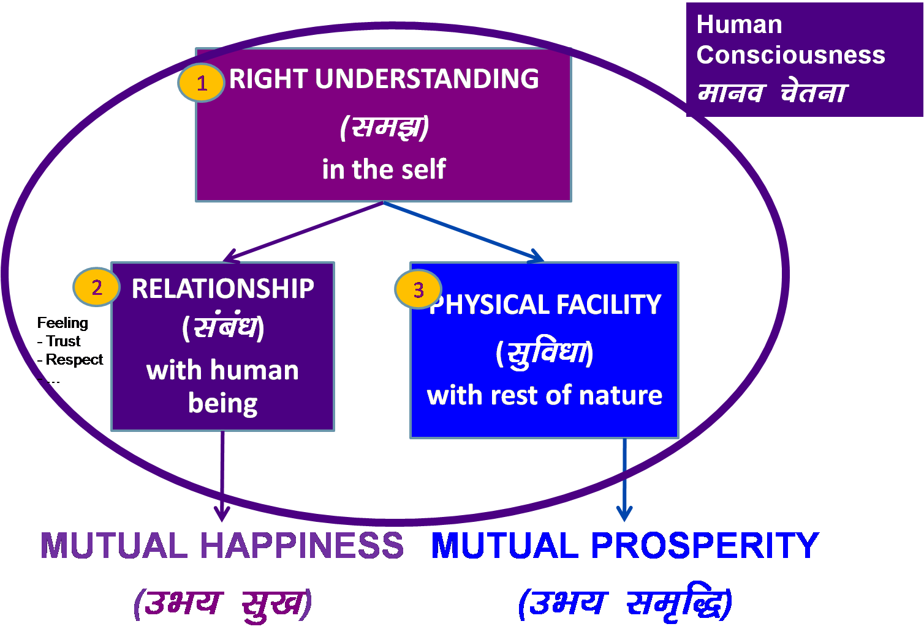
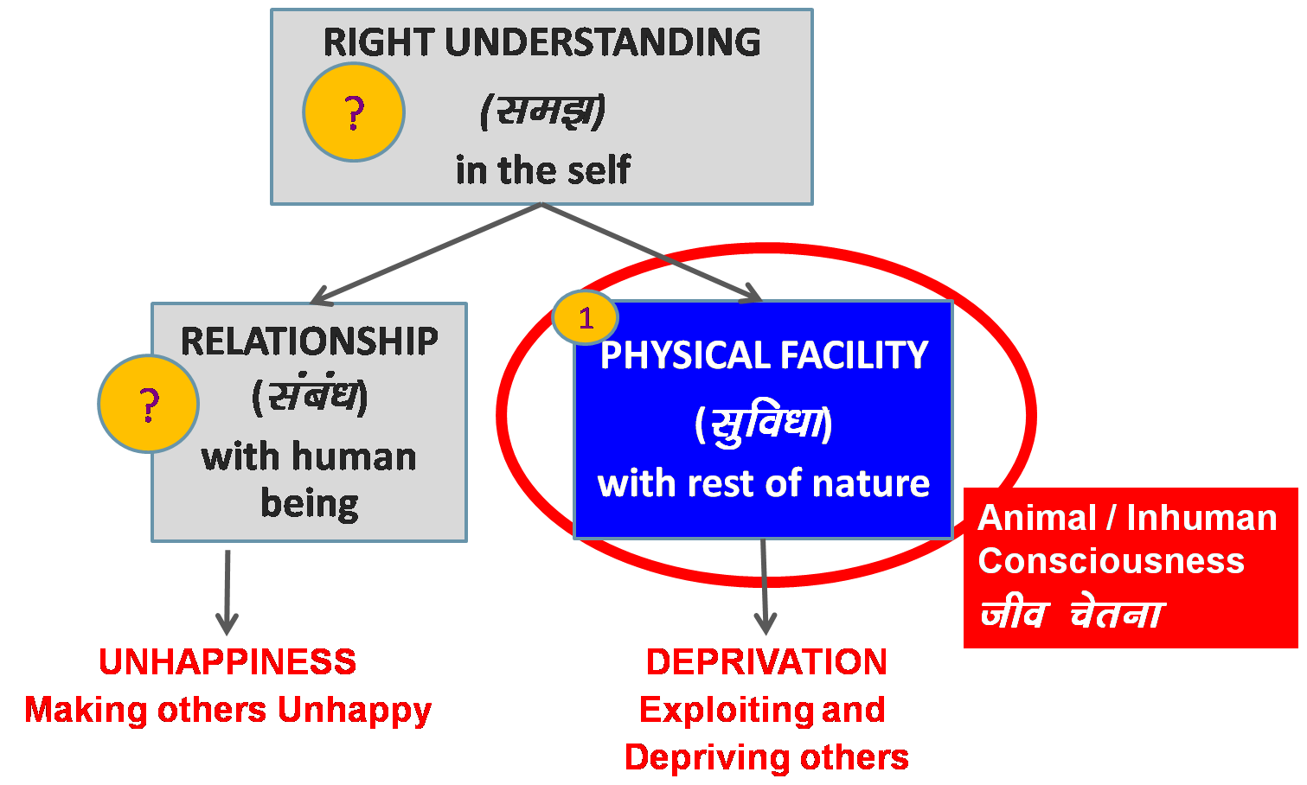
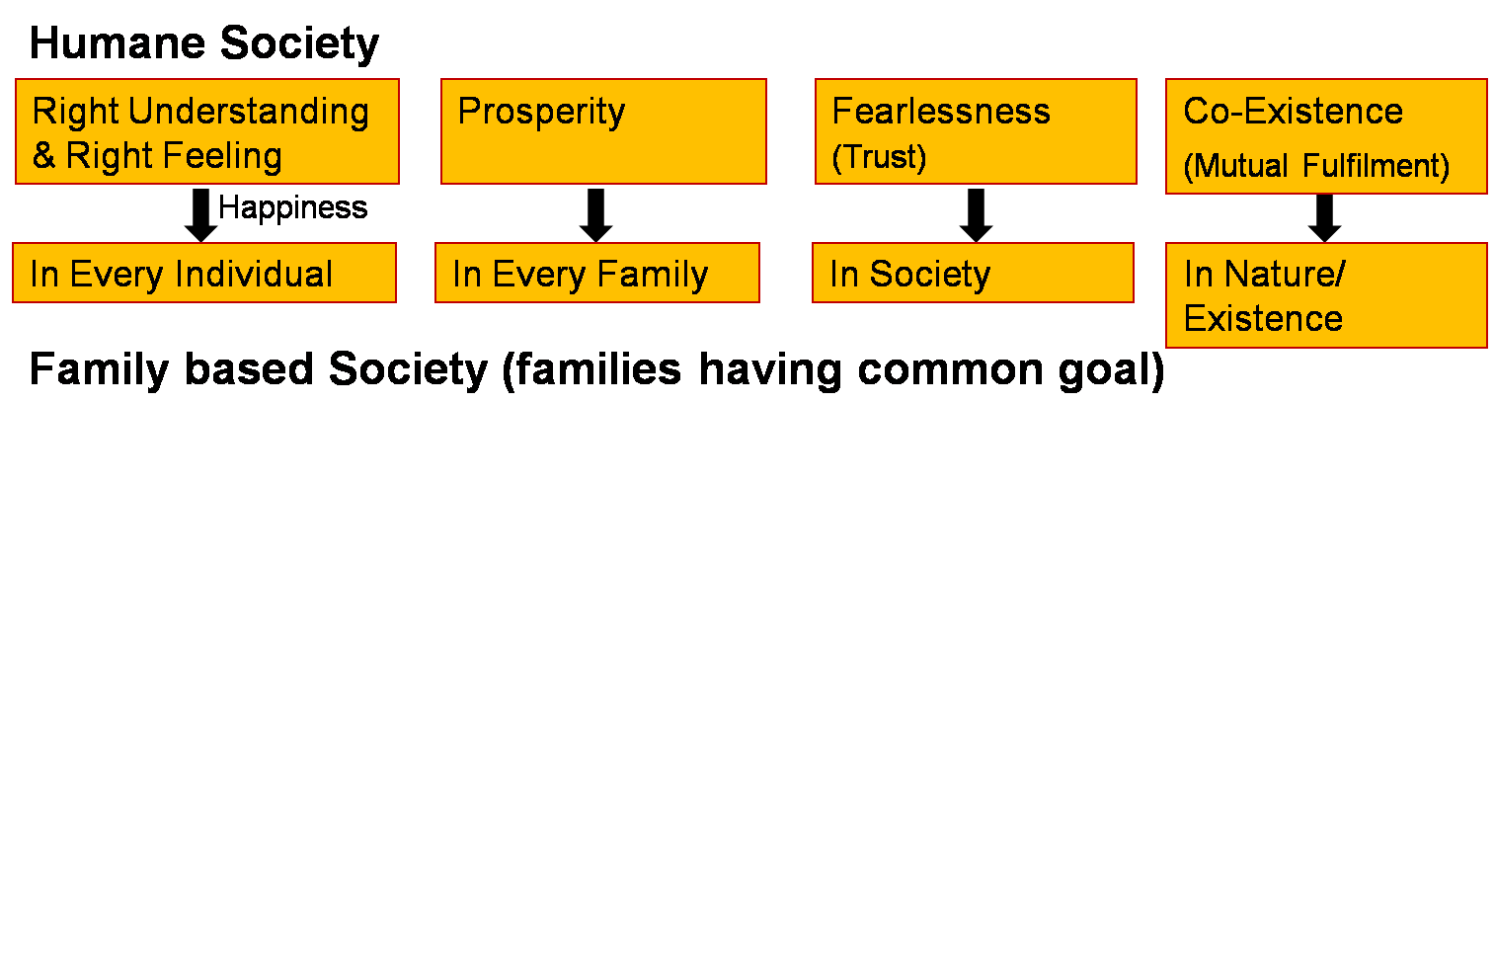
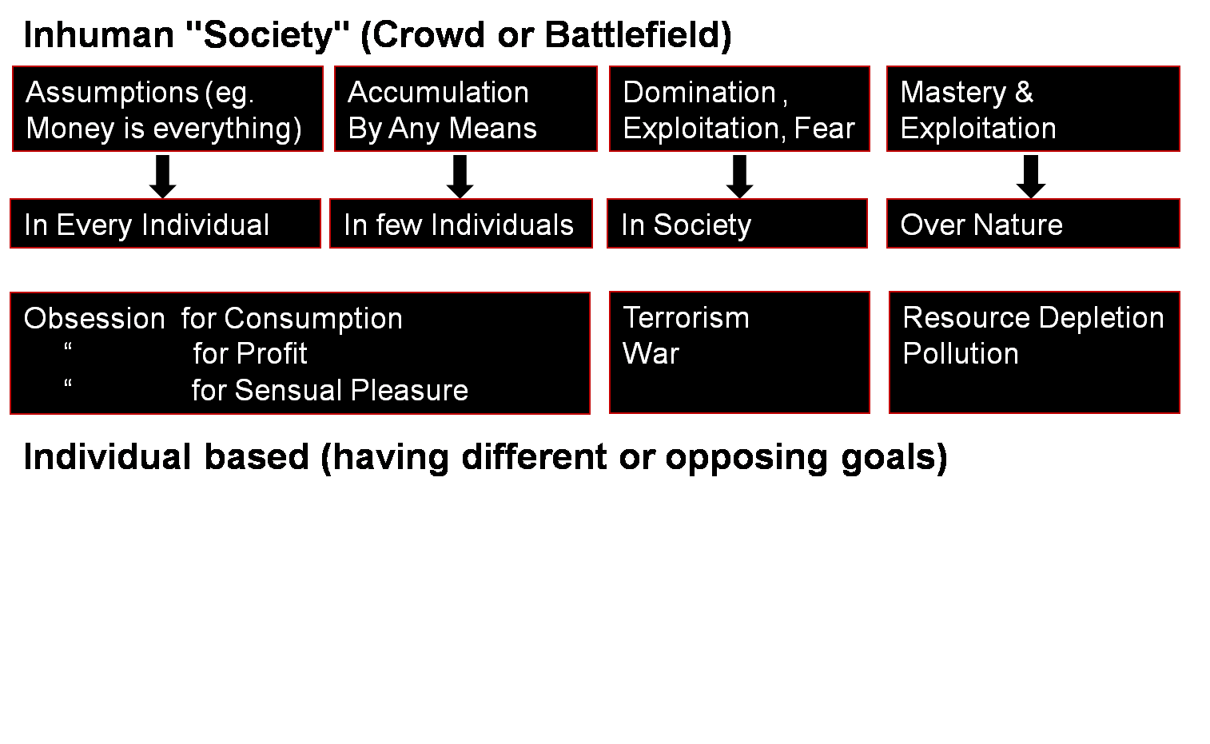
Human Education
Next generation has improved
- Understanding
- Feeling
Human Education
Personal Transformation
Societal Transformation
Transformation& Progress
laØe.k&fodkl

Slide 65
Harmony in the Society
2b. Self-regulation – Feeling of responsibility for Nurturing, Protection and Right Utilization of the Body
2a. Health (Swasthya) –
Body acts according to Self (I)
Parts of the body are in harmony (in order)
→ Recognising What is Needed as Physical Facility

Slide 66
Program for Health-Self Regulation (Self-regulation)
There is a feeling of responsibility in the self(I) toward the body
– for nurturing, protection and right utilization of the body
Program for harmony in the body
1 Intake and Daily Routine (Lifestyle)
2 Labour and Exercise
3 Postures for regulating internal & external body organs and Regulated Breathing
4 Medicine and Treatment
(A) Staying Healthy
(B) Bringing body back to harmony from temporary disharmony
(C) Dependence on drug / machine to perform a body function

Slide 67
Program for Health-Self-regulation
Self-regulation in the Self (I): Feeling of responsibility toward the body – for Nurturing, Protection and Right Utilization of the Body
Program for Self-regulation
1a. Intake 1b. Daily routine
2a. Labour 2b. Exercise
3a. Balancing internal & 3b. Balancing breathing of body
external organs
of body
4a. Medicine 4b. Treatment
Health in the Body
1. Body acts according to Self (I)
2. Parts of the body are in harmony (in order)
1a. Intake includes air, water, sunlight, food (food is nutritious, digestible & tasty and waste is excretable)…
1b. Rising time, sleeping time, eating time…
2a. Outcome of labour is production of physical facility
2b. No physical facility is produced by exercise

Slide 68
System for Health-Self-regulation
Individual Lifestyle, exercise
Family Intake, daily routine
Family cluster Postures, Regulation of breath
Village Medicine
Village cluster / city Health education, environment, treatment
…
Nation Proliferation of good practices
…
World Humane culture, civilisation, tradition

Slide 69
Harmony in the Society
3b. Work: The labour a human being does on the rest of nature
3a. Production: The physical facility obtained out of work

Slide 70
Behaviour Work
With human being
Return of behaviour =
right understanding & right feeling
Mutual happiness
With rest of nature
Return of work =
physical facility
Mutual prosperity

Slide 71
Harmony in the Society
1. What to Produce?
Required Physical Facility (necessary for nurturing, Protection & right utilisation of body)
2. How to Produce?
Mutually Enriching, Cyclic Process (Eco-Friendly)
Ensuring Justice (People-Friendly)

Slide 72
Mutually Enriching, Cyclic Process (Avartansheel Process)
Cyclic
Every Unit in the Process is Enriched
This mutually enriching, cyclic process is already going on in Nature. We do not have to create it
Plants...
Soil, Water,
Air...

Slide 73
Mutually Enriching, Cyclic Process (Avartansheel Process)
Cyclic
Every Unit in the Process is Enriched
This mutually enriching, cyclic process is already going on in Nature. We do not have to create it
Plants...
Soil, Water,
Air...
Animals, Birds

Slide 74
Resource Depletion & Pollution
Resource Depletion – The resource is used at a rate which is faster than the rate at which it is produced in Nature
Pollution – The product is such that
It does not return to the cycle in Nature or
It is produced at a rate that is faster than the rate at which it can return to the cycle in Nature

Slide 75
Mutually Enriching, Cyclic Process (Avartansheel Process)
Cyclic
Every Unit in the Process is Enriched
We, human beings, have to understand the mutual fulfilment in nature & to live accordingly
i.e. To update the man-made processes to be cyclic and mutually enriching
Plants...
Soil, Water,
Air...
Animals & Birds
?
?
√
?
√
√
Human
Beings

Slide 76
Requirement (for Self Sufficiency) Availability
Family of 10
2 acres of land
40 man hrs or work / day
Sufficient to produce what is required for nurturing (food…), protection of body (clothes, shelter, medicine…)
and right utilisation of body (instruments, equipments…)
4 full grown trees – wood for 1 person
90% production in family
10% by exchange / shared by larger order
In India, land availability
2.73 acres of agricultural land for every 10 persons
Total land = 32,87,590 sq km
Forest 21.6%
Agricultural 46.2%
Fallow 8.6%
Built-up/Other 23.6%
Total population = 137 cr
1 sq km = 247.105 acre

Slide 77
Harmony in the Society
4a. Justice – Recognition of Human-Human Relationship, its Fulfillment & Evaluation leading to Mutual Happiness
Notes:
* U;k; lqj{kk& f}rh; egRoiw.kZ vk;ke
U;k;¾ekuo&ekuo laca/k dh igpku] fuokZg]mHk; lq[k
lqj{kk¾ekuo&”ks’k izd`fr laca/k dh igpku] fuokZg]mHk; le`f)
U;k; lqj{kk dh ftEesnkjh gj O;fDr dh gS] ifjokj dh gS] lekt dh gS vkSj varr% jkT; dh gSA
lekt o jkT; esa U;k; lqj{kk dks lqfuf”pr djus dh ftEesnkjh “kklu&iz”kklu dh gSA
jkT; esa vxj U;k;] lqj{kk dh lqfuf”prrk u gks ik;] vogsyuk gks] foijhr gks rks
ml vU;k;] vlqj{kk dks jksdus dh ftEesnkjh U;k;ikfydk o iqfyl dh gSA
U;k; lqj{kk dks lqfuf”pr djus esa “kklu&iz”kklu dk lg;ksx djus dh ftEesnkjh iqfyl dh gSA
U;k; D;k gS\&bls le>uk vko”;d gSA&laca/k] Hkko ewY;&fo”okl] lEeku
lqj{kk D;k gS\ &ijLijiwjdrk
D;k gesa U;k; dh Li’Vrk gS\
D;k ge U;k;iwoZd th jgs gS &Lo;a esa lgh Hkko gS
ifjokj esa lgh Hkko gS] mldk fuokZg dj mHk; lq[k gks jgk gS
fe=ksa esa] lgdfeZ;ksa esa lgh Hkko gS] mldk fuokZg dj mHk; lq[k gks jgk gS
&lekt esa U;k;iwoZd th ik jgs gSa\
&lekt esa vU;k; dks jksd ik jgs gSa\
;gh lc iz”u lqj{kk dks ysdj Hkh gSaA

Slide 78
Harmony in the Society
4b. Preservation – Recognition of Human-Rest of Nature Relationship, its Fulfillment & Evaluation leading to Mutual Prosperity or Mutual Enrichment
Prosperity of Human Being
Enrichment, Protection & Right Utilisation of rest of Nature

Slide 79
Harmony in the Society
5a. Exchange – of physical facility with a view of mutual fulfillment
(not with obsession for profit / of exploitation)
5b. Storage – of physical facility with a view of mutual fulfillment
(not with obsession for profit / of accumulation)

Slide 80
Harmony in Society – Universal Human Order
Human Goal
Systems / Dimensions of Human Order
1. Education – Sanskar -
2. Health – Self-regulation -
3. Production – Work -
4. Justice – Preservation -
5. Exchange – Storage -
Scope –From Family Order to World Family Order (Universal Human Order)
Family – Family cluster – Village – Village cluster ... Nation ... World Family
Order Order Order Order Order Order
~10¹ ~10² ~10¹⁰
Right Understanding & Right Feeling
Prosperity
Fearlessness
(Trust)
Co-Existence
(mutual fulfilment)
Happiness
In Every Individual
In Every Family
In Society
In Nature/ Existence

Slide 81
Sum Up
A society is composed of families living together, in a relationship of mutual fulfillment. They have a common goal, which is:
Right understanding & right feeling (happiness) in every individual
Prosperity in every family
Fearlessness (Trust) in society
Co-existence in nature/existence
The family is the basic unit in society, i.e. society is composed of family, group of families, village family, group of village families, town family… and so on, where every individual is responsible or self-disciplined and self motivated by common values, participating in the larger order toward a common human goal
Through the participation of every family in the society, in the 5 dimensions or social systems, the common human goal is fulfilled for all
– from family order to world family order
– generation after generation
[the current civilization is largely based on the assumption that human being = body, happiness is derived primarily from sensual pleasure & feeling from other; and hence accumulation of physical facility, domination and exploitation is at the core of the socio-economic systems]
1. Education – Sanskar
2. Health – Self-regulation
3. Production – Work
4. Justice – Preservation
5. Exchange – Storage

